Slide 1
Retirement Coordinator Annual Meeting MPAS+ Project Update
June 2021

Slide 2
Agenda
What we’ve accomplished
What we’re working on now
Schedule
Next steps

Slide 3
What We’ve Accomplished
We last met with Retirement Coordinators last June at this meeting
We last met with our Employer Advisory Group in December
Since last June we have
Rolled out mySRPS to all participants
Rolled out a new process for paper Form 9 estimate requests
Rolled out a new Employer Document Storage system to SRA staff
Rolled out new beneficiary change feature on mySRPS
Created a new app for SRA staff for daily payments (e.g., replace check, refund checks, death benefits, etc.)
Published a draft Employer Adjustment Reporting Manual
Made good progress on the new Employer Portal

Slide 4
New Participant Portal: mySRPS
Active Members
Retirees
Benefits
Launched Feb. 10, 2020
More features will be added in future versions as we complete process reengineering (like document upload, update direct deposit, online enrollment, refunds, retirement applications, etc.)
24x7 access
Faster service
More secure
Reduce demands on RCs and SRA Customer Service
Reduce paper
Powerful estimate calculator available for entire career
Record of docs sent
Personal contact info
View account info
Update beneficiaries
Create retirement estimates
Asset verification letter
Print PSB
View document history
Secure messaging
Personal contact info
View account info
Update beneficiaries
Payment history
Income verification letter
Update tax withholding
Print 1099s
View document history
Secure messaging
Enrolled Users | 106,605
Estimates Created | 74,174
Beneficiary Changes | 8,054
Tax Withholding Changes | 4,087

Slide 5
Our New Estimate Process
The new mySRPS benefit estimator is awesome!
Get an official estimate 24x7 at any time during your career
Create assumptions for changes in salary and service, for military service, and for unused sick leave
Save and compare multiple versions
We launched a new way to process the paper Form 9s last November
We redesigned all forms and letters to make them easier to understand and use
We streamlined and automated our paper process (still for members within 12 months of retirement)
“Easy” cases can be completed the same day without staff assistance
“Hard” cases should be completed in days, not weeks.

Slide 6
New Employer Portal – Version 1
Basic Idea
Version 1.0 will provide the current EPDR features, plus:
Enhanced security
You maintain users and roles
Update your contact info
Pay online
View invoices & payments
Secure Messages
Secure file upload
Upload member documents
View employer documents
View employer news
View reports
Benefits
Employer Portal will have new features and functions for Employers and SRA Staff
Control access to Portal – multiple users and roles
Contact info up-to-date
Convenient for providing required docs
Record of docs sent/received
Convenient and secure messages
Receive employer news
Get online help
Get reports in one place, electronically
Notes:
Mention that feature access depends on roles

Slide 7
Key Changes in Employer Portal Version 1
Two factor login process (password & one-time passcode)
Employers setup their own users and roles
Employers setup their banking info for online payments
Employers submit payroll reports and adjustment reports separately
Portal automatically creates an invoice for every payroll and adjustment report
Employers pay invoices online
You can view the status of all invoices in real-time
You can securely send/receive messages
You can securely upload member documents

Slide 8
Electronic Payments – Version 1
Benefits
SRA has started the process to revise the regulations for the new payment process. The regulations includes a provision for an employer to request a waiver from the ACH debit process above. Employers granted a waiver must pay by ACH credit.
You can schedule the payment date
Contribution & payment amounts will always match
Easy payment process
Member data is posted quickly
View status & history of all invoices & payments

Slide 9
What Questions Do You Have?

Slide 10
Employer Portal Version 1 DEMO
Login and home page
View org details
Setup users
Setup bank info
Upload/submit/pay invoice
View employer documents
Upload member documents
Notes:
20 minutes

Slide 11
What Questions Do You Have?

Slide 12
Employer Portal Version 1 DEMO
What we’re still finishing up and couldn’t demo today
Updated help
Secure messages
Reports (AE reports, cutoff notices)
Adjustments

Slide 13
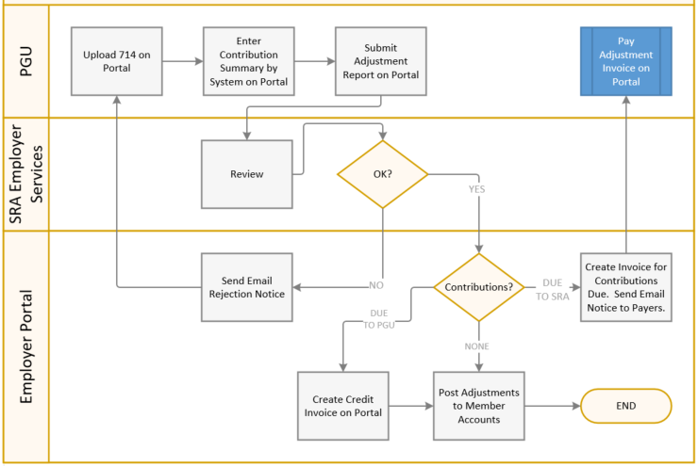
Version 1 Adjustment Process
Changes
Separate from payroll report
Optional – you can submit 714s using the method most convenient for you
Must be an Excel file (we prefer you use the template we provide)
You pay the adjustment invoice we create when we approve your 714 OR we create a credit invoice if negative

Slide 14
What Questions Do You Have?

Slide 15
Electronic Adjustments – Version 2
Basic Idea
Details
Benefits
We shared a copy of the new draft Employer Adjustment Reporting Manual with all payroll contacts. It includes the file specification for the new adjustment file. Comments due back by June 18.
New ability for Employers to report electronic payroll adjustments
Employers can:
Provide employee pay record adjustments with a new file
Indicate for each adjustment record what pay period it’s for
You can report adjustments electronically...no more paper
No limit on the number or timing of adjustments
You provide info on the lump sum and dates, and SRA will do all the math
Positive and negative adjustments for hours, salary, and/or contributions are OK

Slide 16
What Questions Do You Have?

Slide 17
State Agencies
Our goal is to create new processes and tools that work for both PGUs and State agencies
Common user experience
Better training and customer service
Easier and more cost effective to operate and maintain
How will this work
We are providing State RCs access to Version 1 of the new Employer Portal
We are including State staff in our Employer Advisory Group
We will engage the State for new Portal features when the PGU features are working properly

Slide 18
Employer Portal Version Summary
Version 1
New login security
PGUs pay member contributions online
Separates payroll reports and adjustment reports for PGUs (you will be able to see the status of your adjustments)
Version 2
PGUs report all adjustments in a new adjustment file (no more 714s!)
Version 3
New payroll reporting file format
New Roster file
New enrollment process

Slide 19
Employer Portal Version 1 Beta Test
We have 15 employers that volunteered to be Beta testers. We like this size group and are not looking for any more volunteers.
The Beta test employers will use the new Employer Portal instead of EPDR
We will help get our Beta testers trained and ready to go before we launch the Beta test. We plan to have a kickoff meeting with our Beta testers in the next two weeks.
We plan to launch the Beta test in September
We’re not sure how long the Beta test period will last. If everything goes smoothly, probably sixty days.
We’re working on rollout plans now for all other employers.

Slide 20
Employer MPAS+ Schedule
Sept 2021
Launch Employer Portal Beta
Late 2021
Launch Employer Portal Version 2
Mid 2022
Work on Employer Portal Version 3
Launch Employer Portal Version 1
Early 2022

Slide 21
Next Steps
MPAS+ Project Update for Employers: “Employer MPAS+” link on sra.Maryland.gov
Get Employer Portal Version 1 ready for Beta test
Prepare for Version 1 rollout to all employers
Start work on Employer Portal Version 2

Slide 22
What Questions Do You Have?

